Slide 1
Lecture 2:
Subnetting/Supernetting

Slide 2
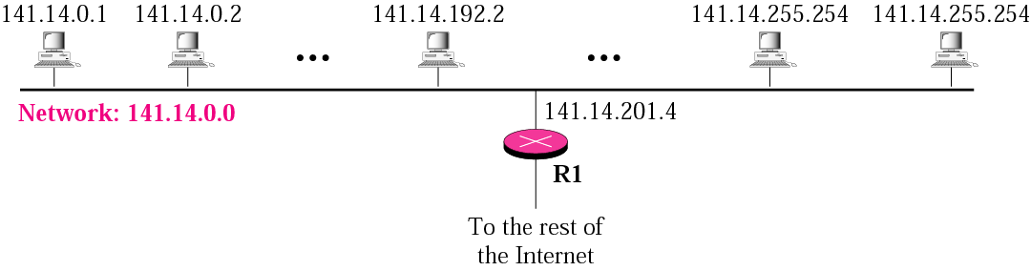
IP addresses are designed with 2 levels of hierarchy: network-ID & host-ID
Fig: A network with two levels of hierarchy (not subnetted)

Slide 3
Two levels of hierarchy is not enough
□ Solution: subnetting
   A network is divided into several
  smaller networks
   Each smaller network is called a
  subnetwork or a subnet

Slide 4
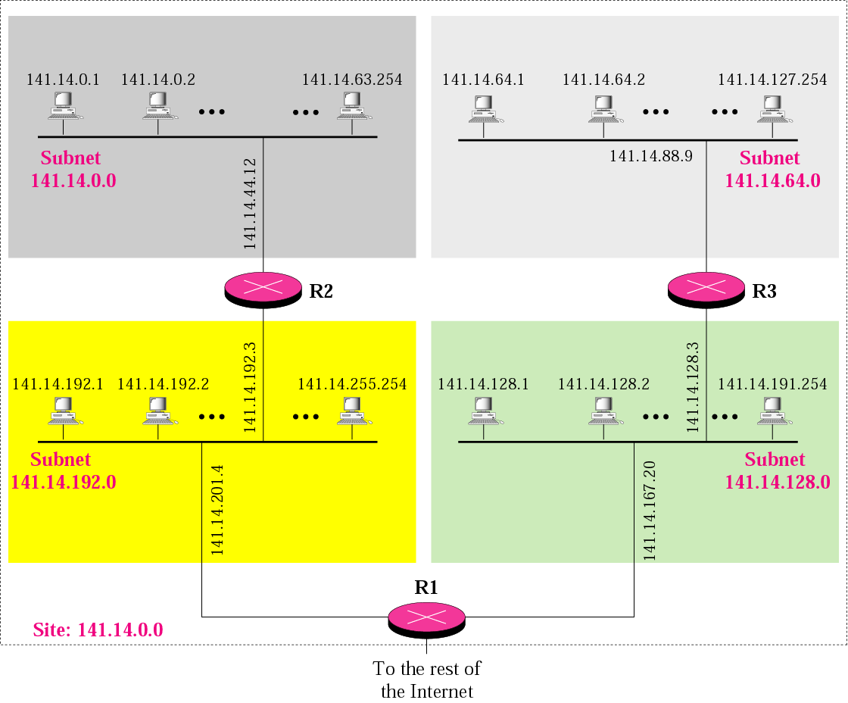
A network with three levels of
hierarchy (subnetted)
Internal routers
External router

Slide 5
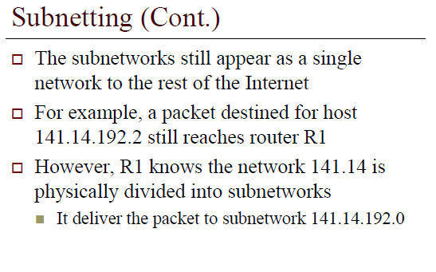

Slide 6
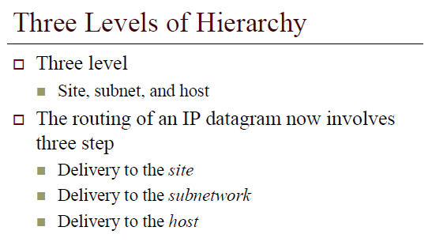

Slide 7
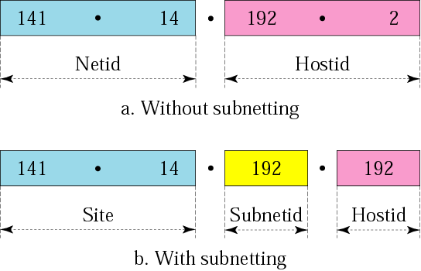

Addresses in a network
With and without subnetting
Just like telephone system

Slide 8
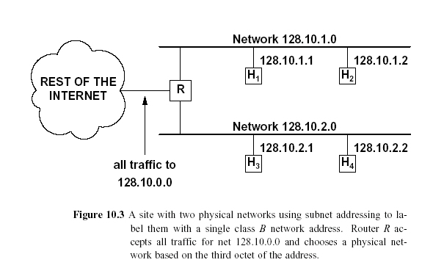
Network Addresses/subnetting
2 Subnetworks
Network Address

Slide 9
IP-Addressing/Subnetting
IP address designed with 2 levels of hierarchy: network-ID & host-ID.
However, often organisation needs to assemble the hosts into groups: the network needs to be divided into several subnetworks (subnets); hence requires 3 levels of hierarchy. (netid: subnetid : hostid)
Remember that, the outside world only knows the organisation by its network address. Inside the organisation each sub-network is recognised by its sub-network address.
In subnetting, a network is divided into several smaller groups that have its own subnet address depends on the hierarchy of subnetting but still appear as a single network to the rest of the Internet.
The question is how a router knows whether it is a network address or a subnet? The key is using the subnet mask. (similar to def. mask).
Only the network administrator knows about the network address and subnet address but router does not. External router has routing table based on network addresses; Internal router has routing table based on subnetwork addresses.

Slide 10
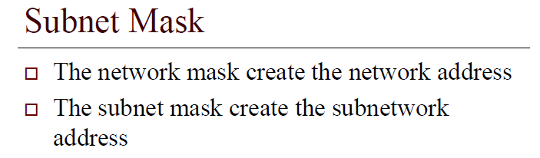

Slide 11
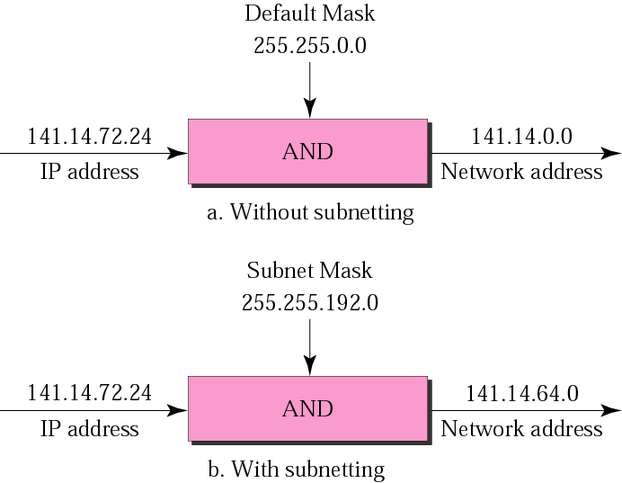
Default mask and subnet mask

Slide 12
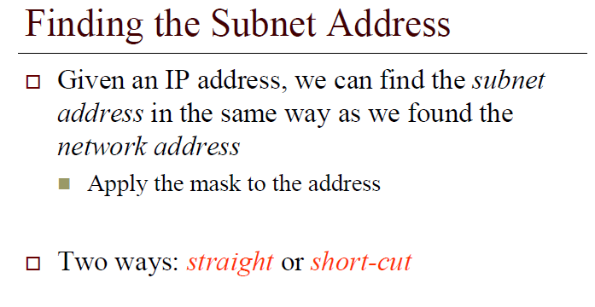

Slide 13
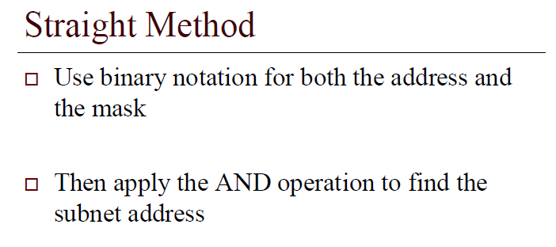

Slide 14
Example-1
What is the subnetwork address if the destination address is 200.45.34.56 given that the subnet mask is 255.255.240.0?

Slide 15
Solution
11001000 00101101 00100010 00111000
11111111 11111111 11110000 00000000
11001000 00101101 00100000 00000000
The subnetwork address is 200.45.32.0.

Slide 16
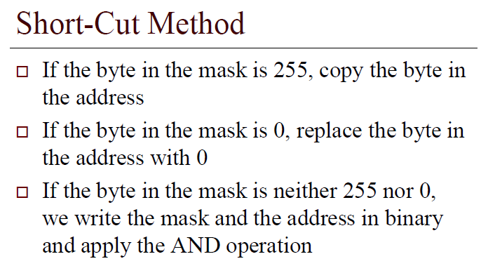

Slide 17
Example-2
What is the subnetwork address if the destination address is 19.30.80.5 and the mask is 255.255.192.0?

Slide 18
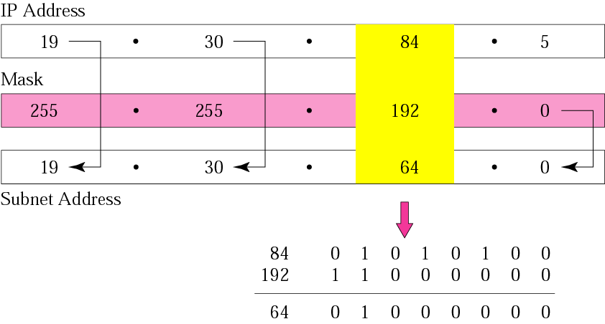
Solution
Answer: Subnet Address = 19.30.64.0

Slide 19
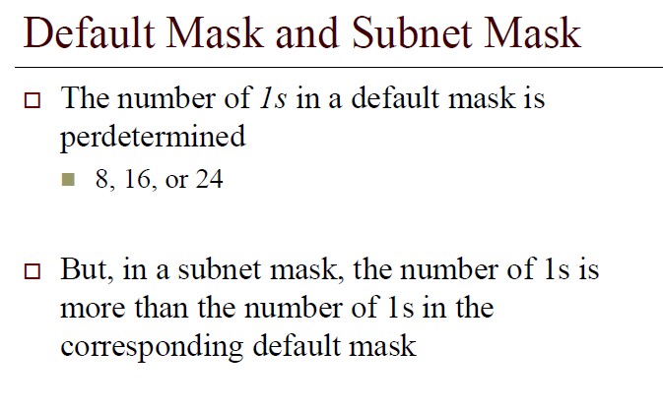

Slide 20
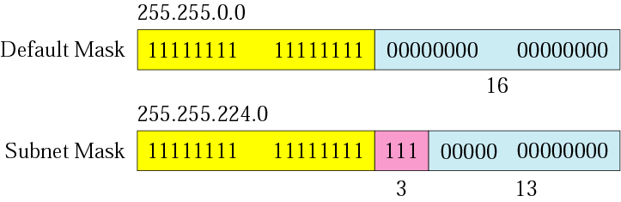

Comparison of a default mask and
a subnet mask
The number of subnets must be
a power of 2.

Slide 21
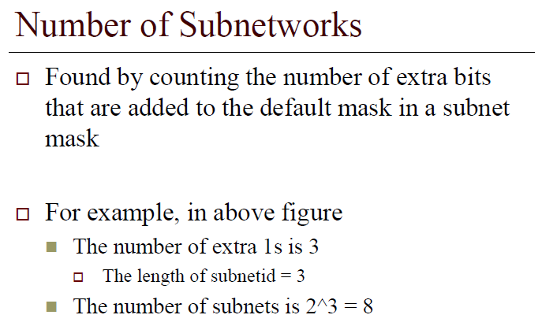

Slide 22
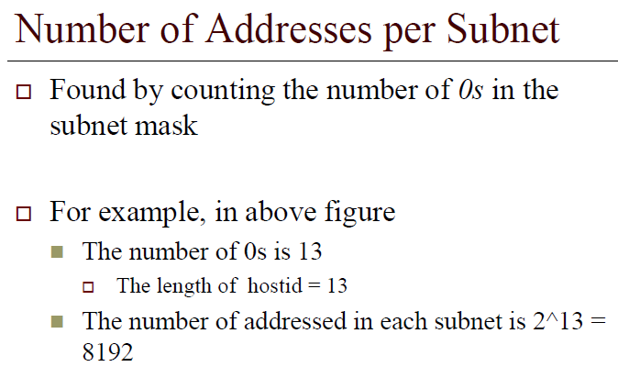

Slide 23
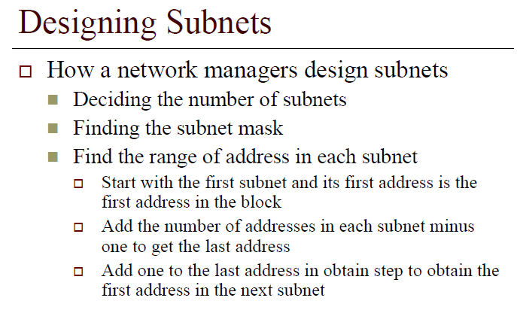

Slide 24
Example-3
A company is granted the site address 201.70.64.0 (class C). The company needs six subnets. Design the subnets.

Slide 25
Solution
The number of 1s in the default mask is 24 (class C).
The company needs six subnets. Since 6 is not a power of 2, the next number that is a power of 2 is 8 (2³). That means up to 8 subnets.
Hence, we need 3 more ‘1’s in the subnet mask = 11111111.11111111.11111111.11100000 or 255.255.255.224
The total number of 1s in the subnet mask is 27 (24 + 3).
Since the total number of 0s is 5 (32 - 27).
    The number of addresses in each subnet is 2⁵ (5 is the number of 0s) or 32.

Slide 26
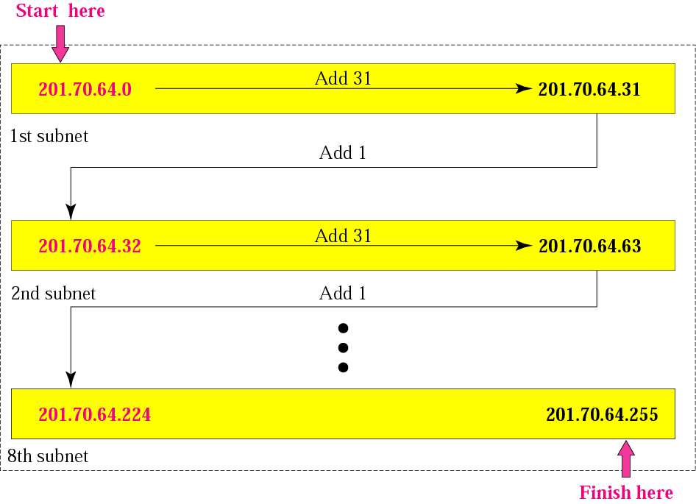
Solution (Continued)

Slide 27
Example
A company is granted the site address 181.56.0.0 (class B). The company needs 1000 subnets. Design the subnets.

Slide 28
Solution
The number of 1s in the default mask is 16 (class B).
The company needs 1000 subnets. Since it is not a power of 2, the next number is 1024 (2¹⁰). We need 10 more 1s in the subnet mask.
The total number of 1s in the subnet mask is 26 (16 + 10).
The total number of 0s is 6 (32 − 26).

Slide 29
Solution (Continued)
The submask is
11111111 11111111 11111111 11000000
or
255.255.255.192
The number of subnets is 1024.
The number of addresses in each subnet is 2⁶ (6 is the number of 0s) or 64.

Slide 30
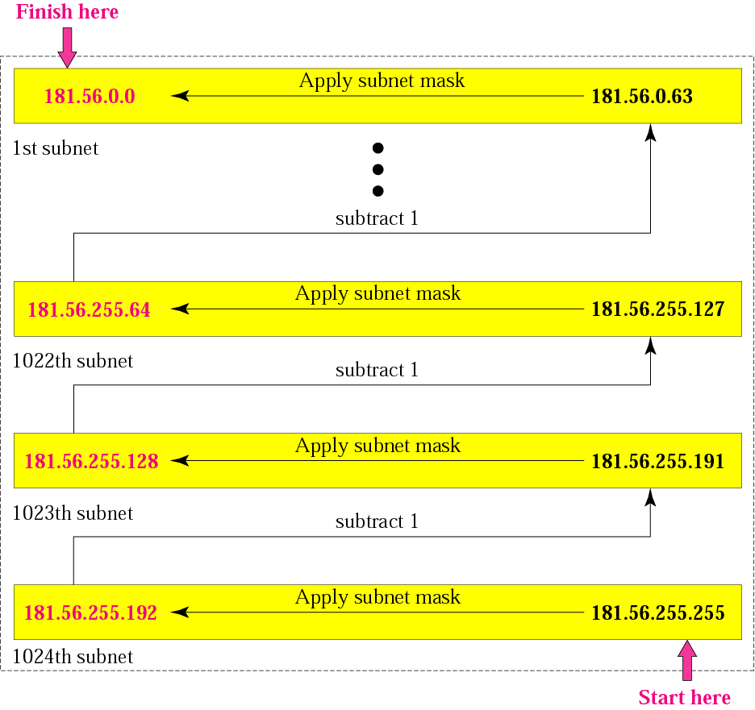
Solution (Continued)

Slide 31
Supernetting
Although class A and B addresses are almost depleted, Class C addresses are still available.
However, the size of a class C block with a maximum number of 256 addresses may not satisfy the needs of an organisation.
One solution is supernetting.
In supernetting, an organisation can combine several class C blocks to create a large range of addresses.
In other words, several networks are combined to create a supernetwork. This is done by applying a set of class C blocks instead of just one.

Slide 32
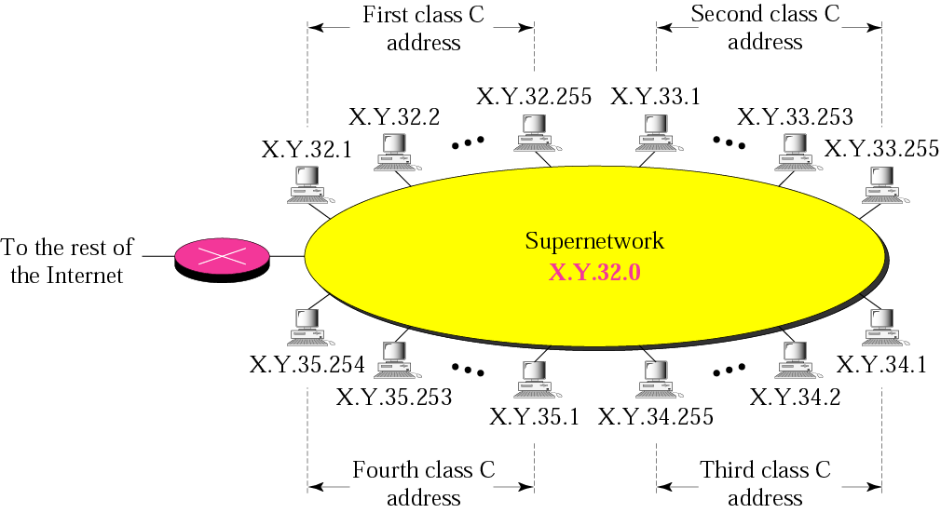
Example of a Supernetwork

Slide 33
Rules:
** The number of blocks must be a power of 2 i.e: (2, 4, 8, 16, . . .).
** The blocks must be contiguous in the address space (no gaps between the blocks).
** The third (3rd) byte of the first (1st) address in the superblock must be evenly divisible by the number of blocks. In other words, if the number of blocks is N, the third byte must be divisible by N.

Slide 34
Example-5
A company needs 600 addresses. Which of the following set of class C blocks can be used to form a supernet for this company?
198.47.32.0 198.47.33.0 198.47.34.0
198.47.32.0 198.47.42.0 198.47.52.0 198.47.62.0
198.47.31.0 198.47.32.0 198.47.33.0 198.47.52.0
198.47.32.0 198.47.33.0 198.47.34.0 198.47.35.0
a.
b.
c.
d.
Solution
a: No, there are only three blocks. (not to the power of 2)
b: No, the blocks are not contiguous.
c: No, 31 in the first block is not divisible by 4.
d: Yes, all three requirements are fulfilled.

Slide 35
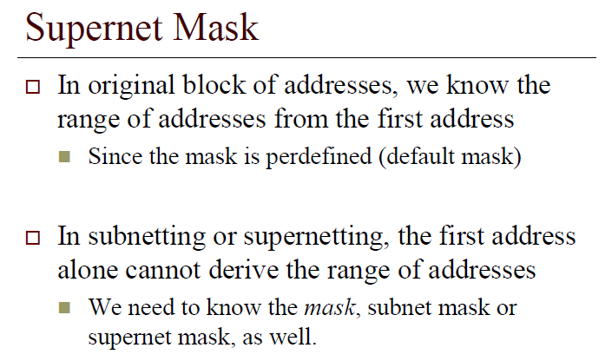

Slide 36
Vital notes: Supernetting
In subnetting,
we need the first address of the subnet and the subnet mask to
define the range of addresses.
In supernetting,
we need the first address of the supernet
and the supernet mask to
define the range of addresses.

Slide 37
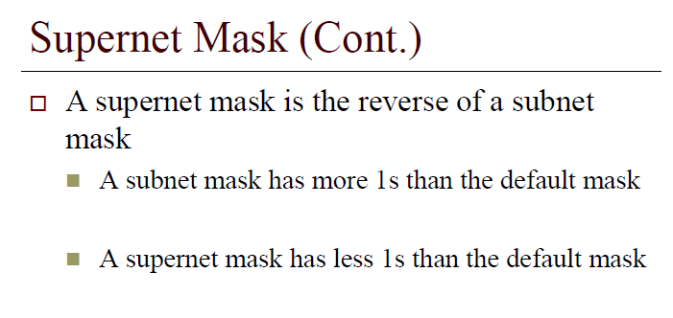

Slide 38
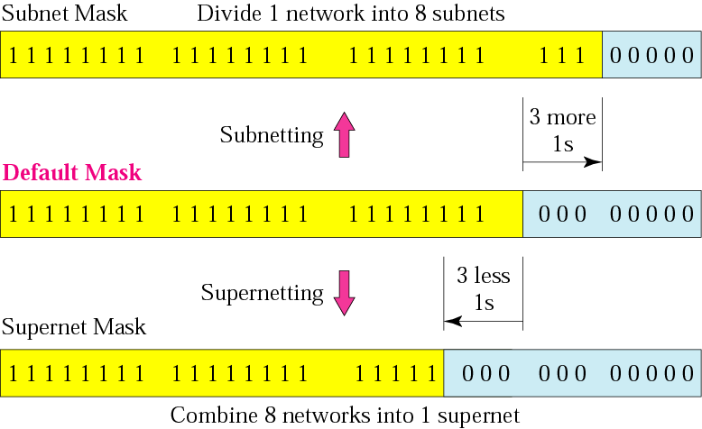
Comparison of subnet, default,
and supernet masks

Slide 39
Example-6
We need to make a supernetwork out of 16 class C blocks. What is the supernet mask?
Solution
Class C mask is defaulted with 24 of ‘1’ is
11111111 11111111 11111111 00000000
We need 16 blocks. For 16 blocks we need to change four 1s to 0s in the default mask. So the mask is
11111111 11111111 11110000 00000000
or
255.255.240.0

Slide 40
Example-7
A supernet has a first address of 205.16.32.0 and a supernet mask of 255.255.248.0. A router receives 3 packets with the following destination addresses:
    205.16.37.44
    205.16.42.56
    205.17.33.76
Q: Which packet belongs to the supernet?

Slide 41
Solution
We apply the supernet mask to find the beginning address.
205.16.37.44 AND 255.255.248.0 ➔  205.16.32.0
205.16.42.56 AND 255.255.248.0 ➔  205.16.40.0
205.17.33.76 AND 255.255.248.0 ➔  205.17.32.0
Only the first address belongs to this supernet.

Slide 42
Example-8
A supernet has a first address of 205.16.32.0 and a supernet mask of 255.255.248.0. How many blocks are in this supernet and what is the range of addresses?

Slide 43
